Slide 1
Operating Systems
Scheduling Algorithms (PART 2)
Dr. Cristina Muntean
cmuntean@ncirl.ie

Slide 2
Topics covered
Brief revision of the last week topics
Scheduling Algorithms
First Come First Served Scheduling Algorithm (FCFS)
Shortest Process First
Shortest Remaining Time First
Round-Robin

Slide 3
5.7 Brief revision
Scheduler = a program that handles the decisions on resource allocation and scheduling processes
Scheduler is activated when a “scheduling event” occurs.
a resource is requested / is released
a process terminates / is ready to start (run)
Scheduling algorithm
determines which process should get the CPU to start to run, when a process has finished to use the CPU.
=> Non pre-emptive scheduling algorithm
Or, determines when to stop one process, temporarily, and give CPU time to another process.
=> Pre-emptive scheduling algorithm

Slide 4
5.7 Brief revision
4 Scheduling Algorithms
Non pre-emptive scheduling algorithms - A process runs until the end of its current CPU burst
A) First Come First Served Scheduling Algorithm (FCFS)
B) Shortest Process First
Pre-emptive scheduling algorithms
C) Shortest Remaining Time First
D) Round-Robin
5

Slide 5
5.7 Brief Revision
A) First Come First Served Scheduling Algorithm (FCFS)
Each process ready to start is put at the end of a Ready queue (FIFO principle)
A process runs (uses the CPU) until the end of its current CPU burst
When the current process finishes, the First-In process in the Ready queue is selected (First Out) to start and use the CPU
B) Shortest Process First
The length of the running time (Burst time) of each process is used to determine which process should start and use the CPU.
When the current running process has finished, the process with the shortest running time is selected first, from the Ready Queue
A short process jumps ahead of longer processes, regardless of the time when it became ready. (no FIFO principle)

Slide 6
5.7 Brief Revision
Performance Metrics
Turnaround time
Time from the request to start (arrival time) until process is completed
Response (Waiting) time
Time from the request to start (arrival time) until process starts to run
Time spent in the Ready queue
Processor utilisation
Throughput
Burst time/ Running time/ Service time
the amount of time a process needs to be in active/running state before completes
5

Slide 7
5.7 Brief revision
4 Scheduling Algorithms
Non pre-emptive scheduling algorithms
A) First Come First Served Scheduling Algorithm (FCFS)
B) Shortest Process First
Pre-emptive scheduling algorithms
C) Shortest Remaining Time First
D) Round-Robin
For algorithm exemplification the following set of processes are considered
Request to run
Process | Arrival Time | Burst/ Service Time
 | 0 | 3
 | 2 | 6
 | 4 | 4
 | 6 | 7
 | 8 | 2
1
2
3
4
5

Slide 8
5.8 Shortest Remaining Time First Algorithm
Principle
Similar to the Shortest Process First, except it is a pre-emptive algorithm
A process may be stopped from execution for a period of time
The length of the (remaining) execution time of each process is used to determine which goes next.
When the algorithm is activated ?
The current running process has finished, and/or CPU is available and a process is ready to start
When a new process becomes ready to start and its next running (burst) time is shorter than the remaining time of the running process, the running process will get pre-empted (i.e. - it will lose the CPU, and get put on the ready queue)
Action taken by the algorithm
the ready process with the shortest running / remaining time is selected first
FIFO principle is NOT applied on the Ready queue

Slide 9
5.8 Shortest Remaining Time First Algorithm
Notes:
It provides the best turnaround time among pre-emptive algorithms
Usually it is difficult to implement
Must estimate process running time

Slide 10
5.8 Shortest Remaining Time First Algorithm
Exemplification
Process | Arrival Time | Service/Burst Time
 | 0 | 3
 | 2 | 6
 | 4 | 4
 | 6 | 7
 | 8 | 2
1
2
3
4
5
Shortest Remaining Time First
0
1
2
3
4
5
6
7
8
9
10
11
12
13
14
15
16
17
18
19
20
21
22
A
P 1
3
P 2
A
1
5
P 3
A
4
P 4
A
7
P 5
A
2

Slide 11
5.8 Shortest Remaining Time First Algorithm
Performance Metrics computation for pre-emptive algorithms
Turnaround time
Time from the request to start (arrival time) until process is completed
OR, the amount of time between the moment a process enters the ready queue for the first time and the moment the process exits the running state for the last time
Response (waiting) time
Time from the request to run (arrival time) until process starts to run for the first time
OR, the time the process waits in the ready state before its first transition in the active state

Slide 12
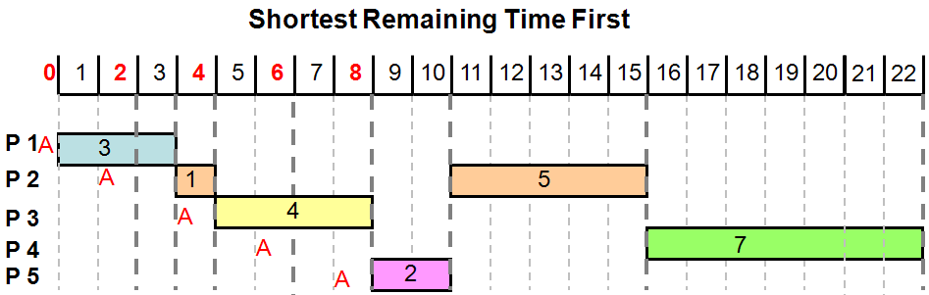
5.8 Shortest Remaining Time First Algorithm
Performance Metrics
Response Time
P1 = 0 time units
P2 = 1 time units
P3 = 0 time units
P4 = 9 time units
P5 = 0 time units
Avg RespTime =( 0+1+0+9+0) / 5 = 2.0
Process | Arrival Time | Burst/Service Time
 | 0 | 3
 | 2 | 6
 | 4 | 4
 | 6 | 7
 | 8 | 2
1
2
3
4
5

Slide 13
5.8 Shortest Remaining Time First Algorithm
Performance Metrics
Turnaround = Complete BurstTime – Arrival Time
P1 = 3 - 0 = 3 time units
P2 = 15 - 2 = 13 time units
P3 = 8 – 4 = 4 time units
P4 = 22 – 6 = 16 time units
P5 = 10 – 8 = 2 time units
Avg Turnaround=( 3+13+4+16+2) / 5 = 7.6 time units
Process | Arrival Time | Burst/Service Time
 | 0 | 3
 | 2 | 6
 | 4 | 4
 | 6 | 7
 | 8 | 2
1
2
3
4
5

Slide 14
5.9 Round-Robin Algorithm
Principle
Assumes that all processes are equally important
Uses pre-emption based on clock
Each process is assigned an equal time interval, (quantum) in which it is allowed to run
Each process that wants to run is put at the end of a Process Ready queue (FIFO principle is applied)
When the algorithm is activated ?
The current running process has finished, and/or CPU is available
The quantum has expired for the current running process
Action taken by the algorithm
If the running process still needs to run, at the end of its quantum, the CPU is pre-empted and given to another ready process
The current process is put in a Ready queue and waits for another quantum, if still needs to run.
The oldest process in the Ready queue (head of queue) is selected as the next process to run ( FIFO principle)

Slide 15
5.9 Round-Robin Algorithm
Notes:
A quantum = 10 - 100 ms or less
small quantum: too many process switches, increases switching overhead, lowers the CPU efficiency
large quantum: fewer process switches, increases CPU efficiency, possible poor response time
There is a trade off between the scheduling efficiency and the overhead involved

Slide 16
5.9 Round-Robin Algorithm
Exemplification
Quantum = 2
Process | Arrival Time | Service Time
 | 0 | 3
 | 2 | 6
 | 4 | 4
 | 6 | 7
 | 8 | 2
1
2
3
4
5
Round-Robin
0
1
2
3
4
5
6
7
8
9
10
11
12
13
14
15
16
17
18
19
20
21
22
P 1
2
A
1
P 2
A
2
2
2
P 3
A
2
2
P 4
A
2
5
P 5
A
2

Slide 17
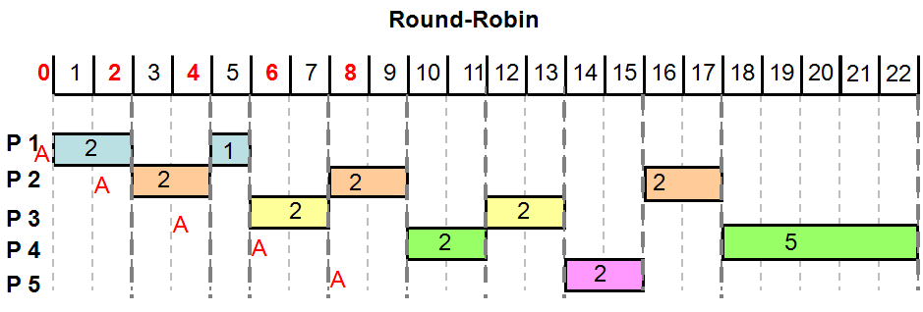
5.9 Round-Robin Algorithm
Performance Metrics
Response Time
P1 = 0 time units
P2 = 0 time units
P3 = 1 time units
P4 = 3 time units
P5 = 5 time units
Avg RespTime =( 0+0+1+3+5) / 5 = 1.8
Process | Arrival Time | Burst/Service Time
 | 0 | 3
 | 2 | 6
 | 4 | 4
 | 6 | 7
 | 8 | 2
1
2
3
4
5

Slide 18
5.9 Round-Robin Algorithm
Performance Metrics
Turnaround = Complete BurstTime – Arrival Time
P1 = 5 - 0 = 5 time units
P2 = 17 - 2 = 15 time units
P3 = 13 – 4 = 9 time units
P4 = 22 – 6 = 16 time units
P5 = 15 – 8 = 7 time units
Avg Turnaround=( 5+15+9+16+7) / 5 = 10.4 time units
Process | Arrival Time | Burst/Service Time
 | 0 | 3
 | 2 | 6
 | 4 | 4
 | 6 | 7
 | 8 | 2
1
2
3
4
5

Slide 19
5.10 Exercises
Exercise 1
Same set of processes from Tutorial 5
Illustrate how the six processes will run under
Shortest Remaining Time First scheduling algorithm
Round Robin scheduling algorithm
Compute
Turnaround time
Response time
Process Name | Arrival Time | Burst/ Service time
P1 | 0 | 4
P2 | 2 | 1
P3 | 3 | 6
P4 | 8 | 2
P5 | 9 | 5
P6 | 12 | 2

Slide 20
5.10 Exercises
Exercise 2
Illustrate how the three processes will run under
Shortest Remaining Time First scheduling algorithm
Round Robin scheduling algorithm
Shortest Remaining Time First
Round Robin
Compute
Turnaround time
Response time
Process | Arrival Time | Service/Burst Time
 | 0 | 8
 | 2 | 5
 | 3 | 2
1
2
3

Slide 21
Learning Outcome
After this lecture you should have an understanding of the purpose of the scheduler in the typical Operating System.
You should be able to
Describe Shortest Remaining Time First and Round Robin algorithms
Exemplify how these two algorithms would run a set of processes

